Slide 1
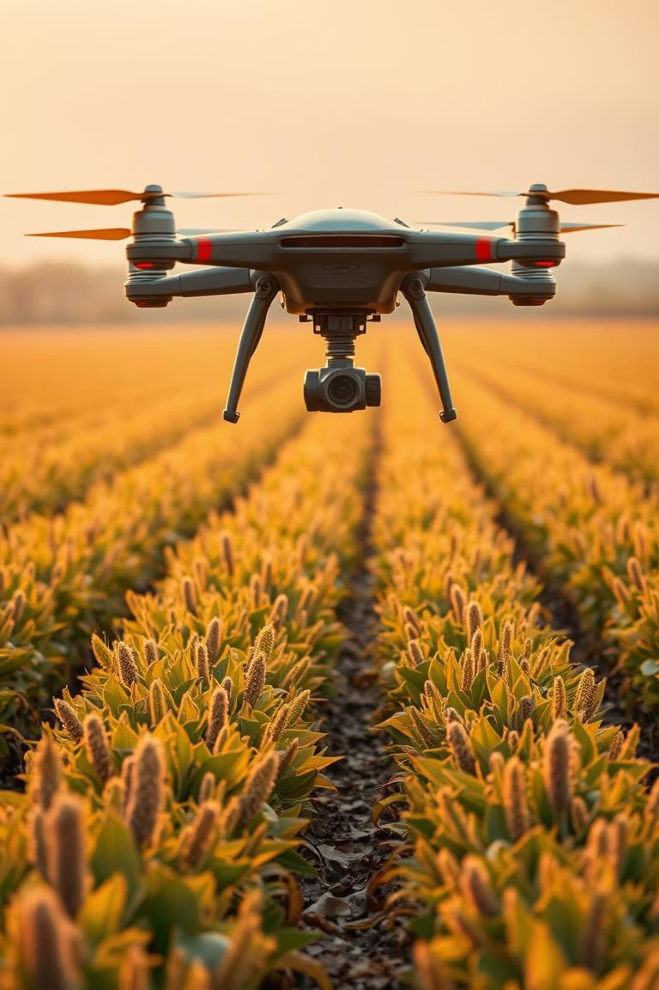
Smart Agriculture Assistant using Deep Learning and NLP
Course: Deep Learning and Reinforcement Learning
Aneesh M S – 1BG23CS014
Divyashree D – 1BG23CS036
Kshithija K M – 1BG23CS064

Slide 2




Project Objective: Revolutionizing Agriculture
Optimize Crop Yields
Leverage historical data to predict optimal crop growth conditions.
Empower Farmers
Provide actionable insights through an intelligent assistant.
Natural Language Interaction
Enable intuitive communication with agricultural knowledge.

Slide 3
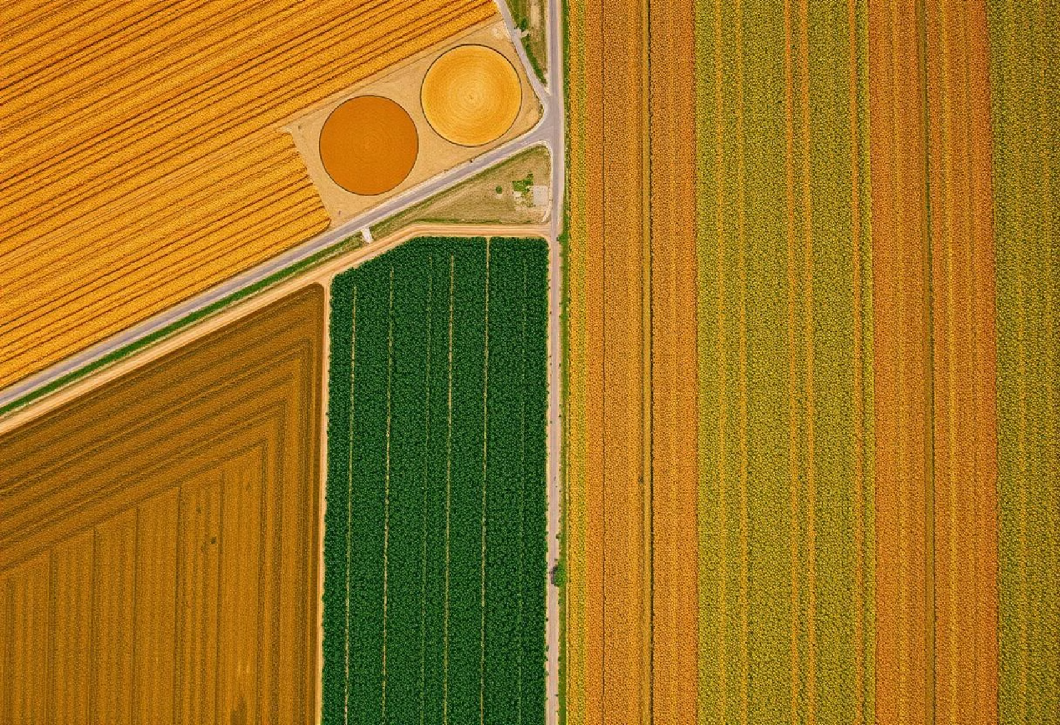
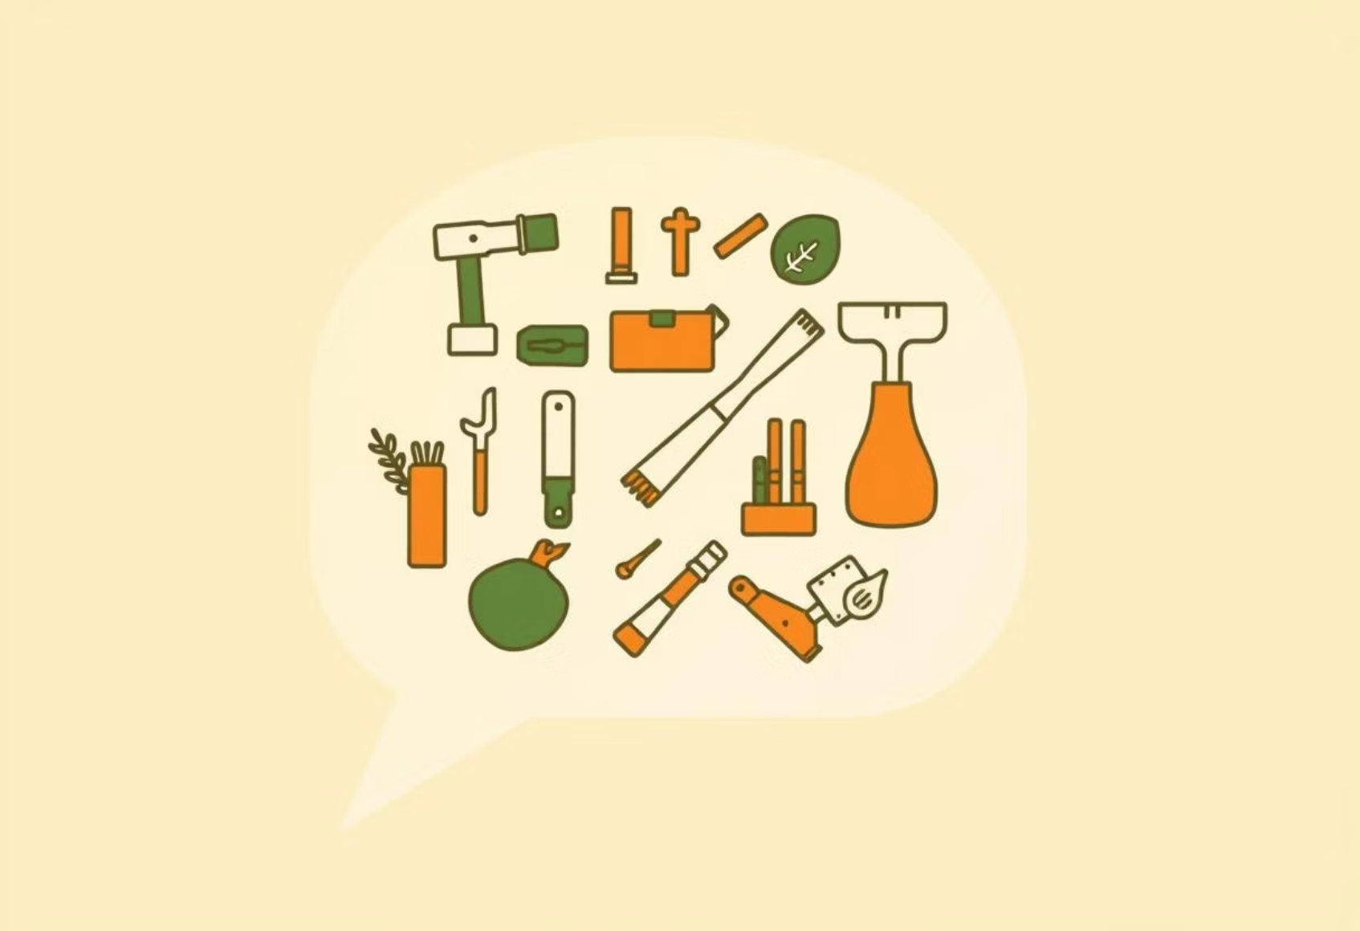
Methodology: Integrated Approach
Crop Prediction Model
NLP Chatbot
Uses deep learning for accurate crop yield forecasts.
Provides instant answers to agricultural queries.
Satellite imagery analysis for vegetation health.
Rule-based system for precise information retrieval.
Historical weather data integration.
Extensive agricultural knowledge base.
Yield forecasting for various crop types.
User-friendly interface for farmers.

Slide 4

Key Assumptions for Model Accuracy
NDVI Range Validity
NDVI values accurately reflect crop health and growth stages.
Rainfall Data Precision
Rainfall data within specified ranges influences yield directly.
Consistent Data Quality
Input data for training is clean and consistently reliable.
Environmental Stability
Assumes no sudden, unmodeled environmental disasters.

Slide 5
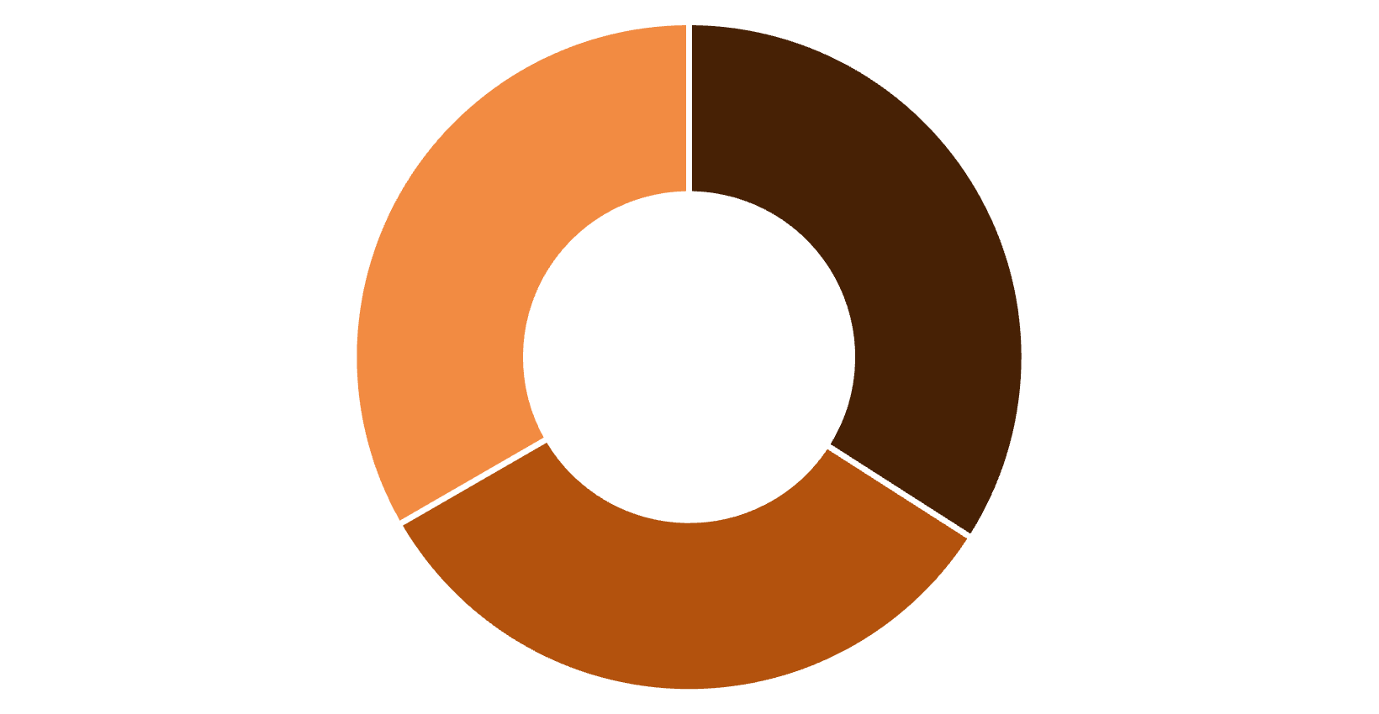
Model Evaluation and Performance
Crop Prediction: Random Forest
Random Forest excels in handling diverse agricultural data.
High accuracy in yield prediction.
Robustness against outliers and noise.
Interpretability of feature importance.
Accuracy
Precision
Recall
The Random Forest model demonstrated strong performance.

Slide 6
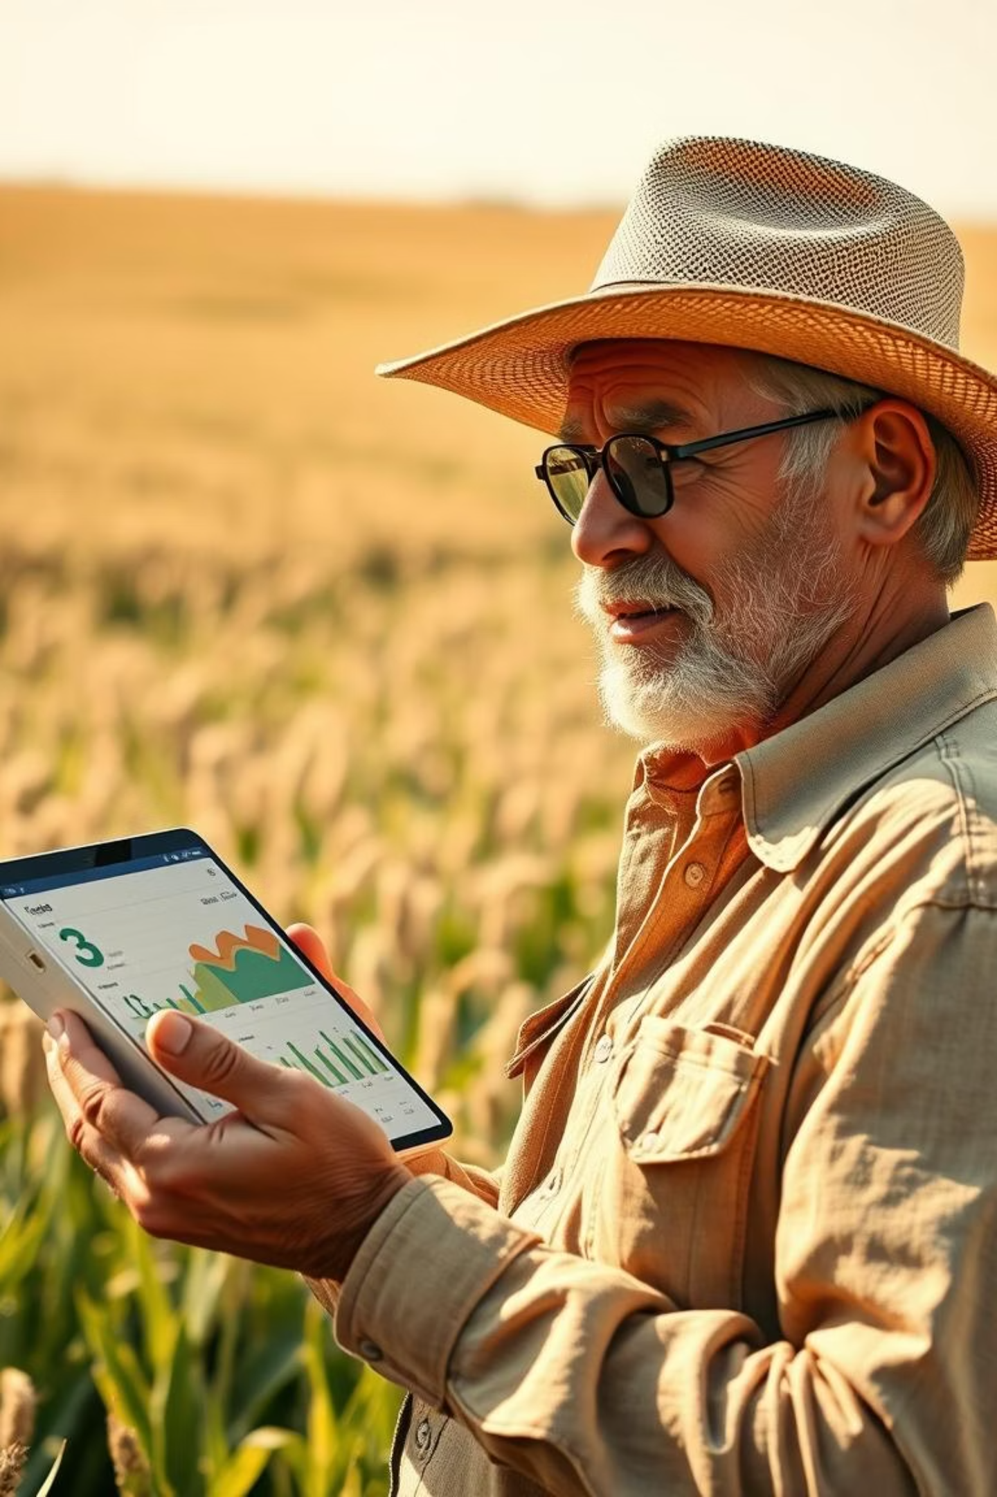
Project Summary: Key Achievements
Functional Prediction Model: Successfully developed a deep learning model for crop yield forecasting.
Interactive NLP Chatbot: Created a rule-based chatbot providing agricultural advice.
Data Integration: Seamlessly combined diverse datasets for comprehensive insights.

Slide 7





Future Improvements: Expanding Capabilities
Advanced Deep Learning
Explore more complex neural network architectures.
Real-time Data Integration
Incorporate live weather and sensor data for dynamic updates.
IoT Sensor Integration
Connect with on-farm sensors for hyper-local data.
Broader Crop Support
Expand the system to support a wider variety of crops.

Slide 8

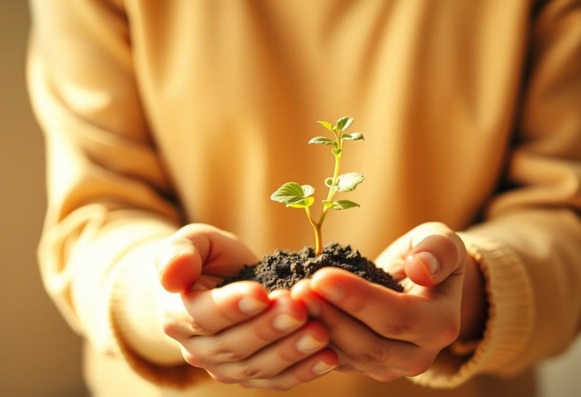
Reflections and Learnings
Challenges Overcome
Key Takeaways
Managing diverse agricultural datasets.
Deep learning has immense potential in agriculture.
Optimizing model performance for accuracy.
NLP enhances accessibility for farmers.
Designing an intuitive chatbot interface.
Interdisciplinary approach yields powerful solutions.

